Slide 1

Hillcrest High School
How to Access
Your Course

Slide 2
Let’s get started!
Hi students,
Following the recent workshop, Elevate Education will be working with us to assist you across the rest of the year.
They have moved their workshops online to their platform Elevate Online. The platform has videos to watch and activities to complete. We have arranged for you to have access to the “Study Skills Kick Start” courses. This is available in English and Afrikaans. Don’t worry if some of these look unfamiliar to you now – you might still have these seminars over the course of the year!
Follow the registration process, and it will automatically direct you to your course from there. If you have any issues, reach out to Elevate Education on the website’s in-built chat function.
Good luck!

Slide 3
Technology requirements
Things for teacher to check first with the IT department:
□ Video Player: All videos are served through Vimeo. Does your school blacklist Vimeo? If so, is it possible to get it whitelisted?
□ IP Address: Please send your school’s IP address so that we can whitelist it on the site to prevent any access issues for students. The easy way to do this is to Google ‘My IP address' on a school computer and Google will tell you. Please copy this information from Google and send it to us via email.

Slide 4
Technology requirements
Things for students to know:
□ Browser: Elevate Online is best viewed through Chrome or Microsoft Edge. Do not use Safari or Firefox.
□ Email Address: When creating your account, please make sure that you use your school email address. That is to say, please use the email address given to you by your school, which should contain your school’s email domain name.

Slide 5
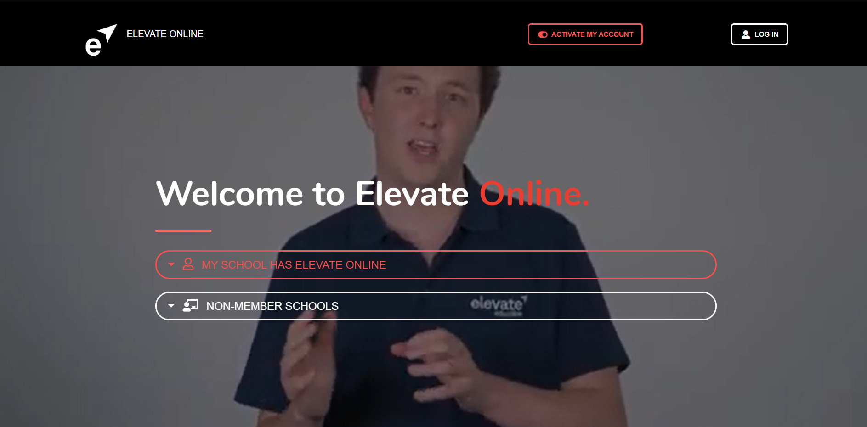
Step 1. Activate Your Account
Go to: www.elevateeducationonline.com and click on ‘Activate My Account’.

Slide 6
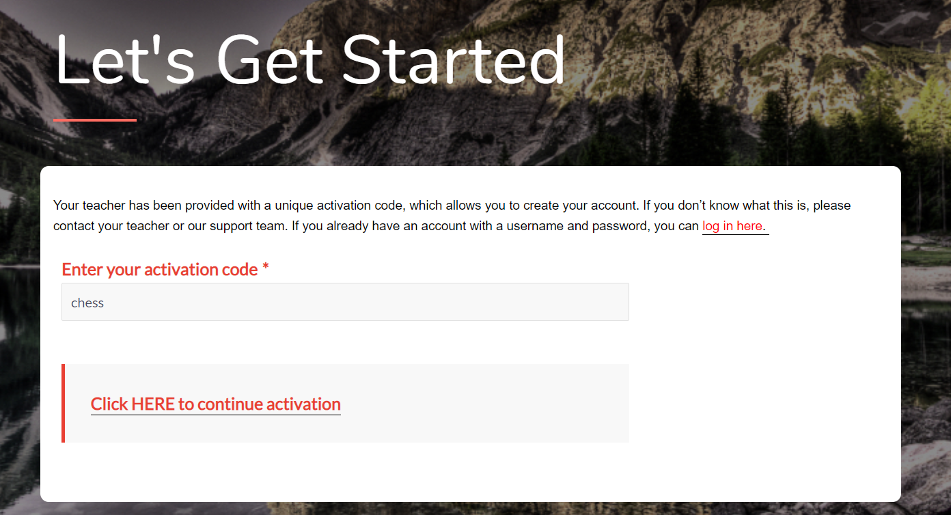
Step 1. Activate Your Account
Enter the activation code. Your activation code is: chess
Make sure that you use lower case (small letters) for the activation code.
When you’re done, click here.

Slide 7
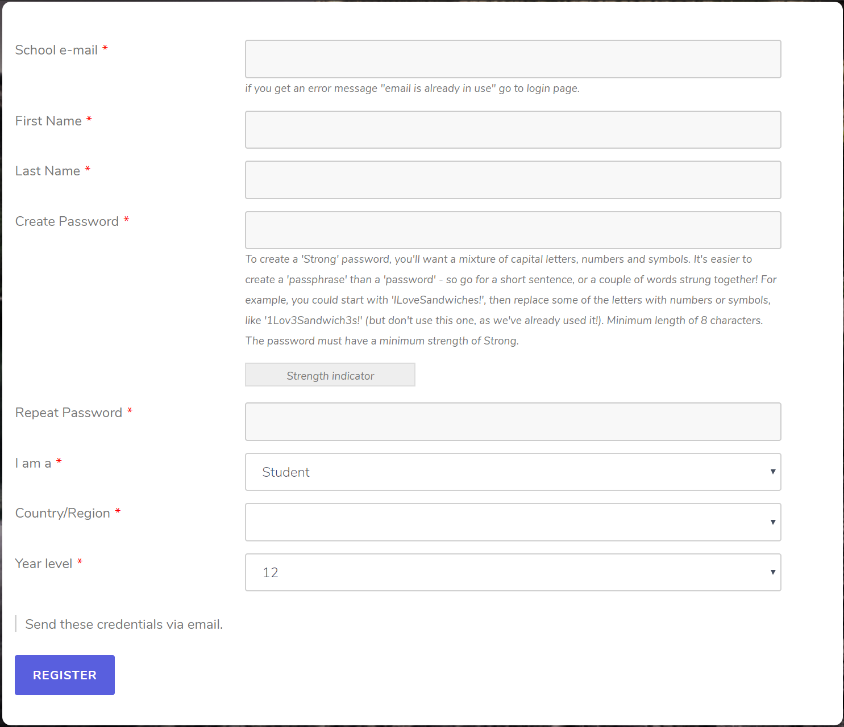
Step 2. Register
Strong password =
At least 10 characters
1 capital letter
1 number
1 symbol
e.g. STUDY*SKILLS*2021%
If it comes up only as medium strength add another word, more capitals, symbols or numbers
Fill in the form!
Make sure you fill in all details correctly.
‘Year level’ refers to the grade you are in.
Select your school from the dropdown list.

Slide 8
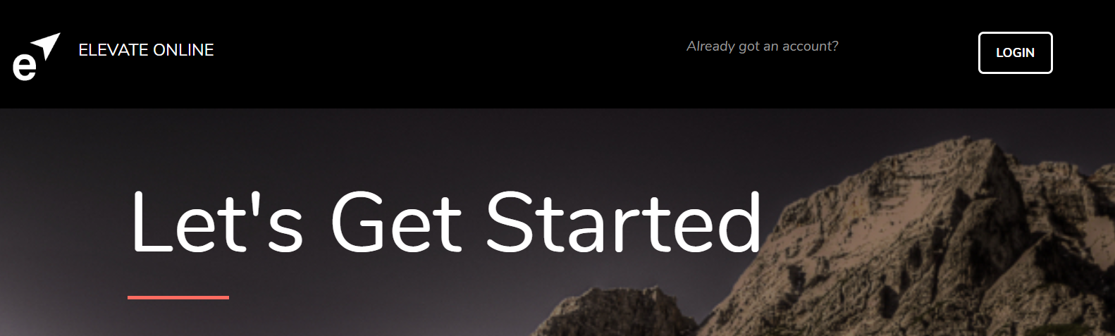
Step 3. Find Your Course
Within 5 seconds, you should be redirected to the Course Library. If not, click LOGIN and sign in using the account details you just created.

Slide 9
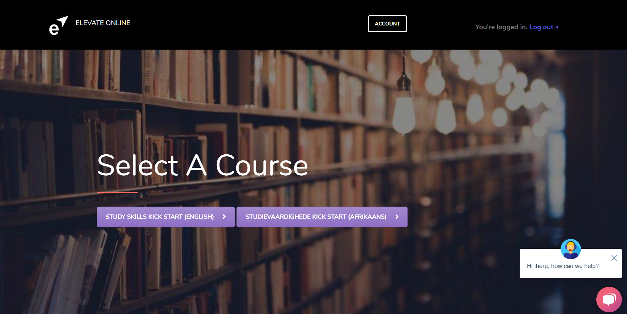
Step 3. Find Your Course
Select your course – STUDY SKILLS KICK START

Slide 10
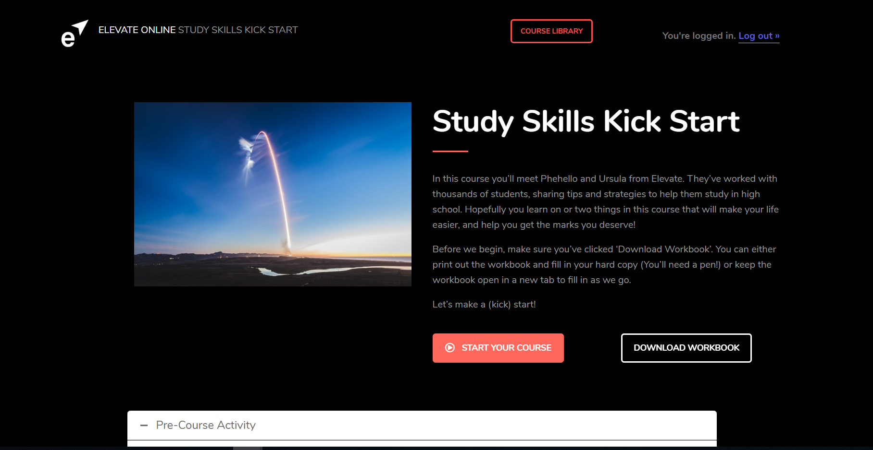
Step 4. Begin!

Slide 11
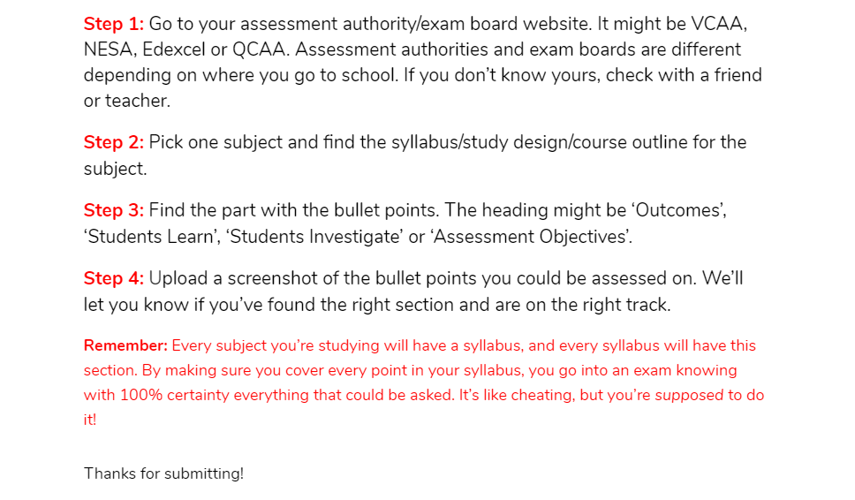
Things to be aware of!
Uploading work
When you upload course work you will see a “Thank you” message.
Don’t worry if that message disappears or it says ‘Choose File’ again next time you log in. If you got a “Thank you” message your work has been received!

Slide 12
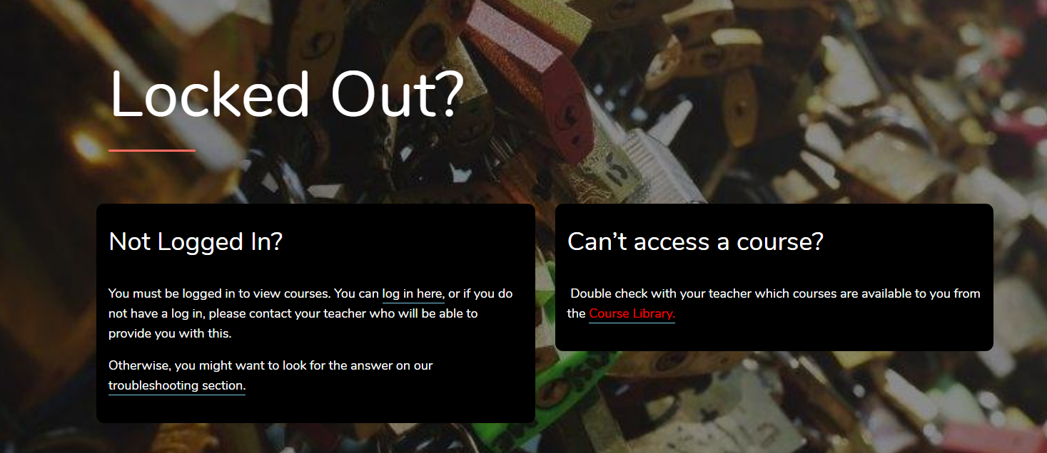
Things to be aware of!
If you can’t access your course or it says you have been locked out
There are 2 reasons this can happen.
1. You are clicking on the wrong course. Make sure you know which course your school has signed you up for!
2. You aren’t logged in. This can be confusing, as you might be in the Course Library, and can see the course picture! If this happens, click on the log in button.

Slide 13
Things to be aware of!
Can’t write in or save the workbook / manual?
There is a downloadable writable PDF workbook for each module. If you…
Can’t write in it?
Check your browser. Writable PDFs don’t work in Firefox or Safari. Instead, try a different browser, preferably Chrome, Explorer or Edge.
Can’t save it with your answers?
If you have completed the workbook and want to save your answers simply go “Print”, then pick from the list of printer options and pick either “Save to PDF” or “Print to PDF”.

Slide 14
Things to be aware of!
I can’t navigate back to the log-in page or Course Library!
Once you have created your account, you can navigate back to the log-in page by going
to: www.elevateeducationonline.com/login/
You can navigate back to the Course Library by going to: www.elevateeducationonline.com/courses/

Slide 15

Having trouble?
If you’re having trouble at any stage, head here:
www.elevateeducationonline.com/troubleshooting/
You can either speak to us on the ‘Chat’ – the pink bubble in the bottom right corner of the screen or fill in the ‘Ask a Question’ form.

Slide 16


